Slide 1
Tree Structure Analysis

Slide 2
Combinations Tested
Constant tree:
Single input output
Multi input single output
Single input multi output
X inputs Y outputs (1 < X < Y)
X inputs Y outputs (1 < Y < X)
Linear tree:
Single input output
Multi input single output
Single input multi output
X inputs Y outputs (1 < X < Y)
X inputs Y outputs (1 < Y < X)
Single categorical input
Mixed numerical & categorical input
Multi categorical input

Slide 3
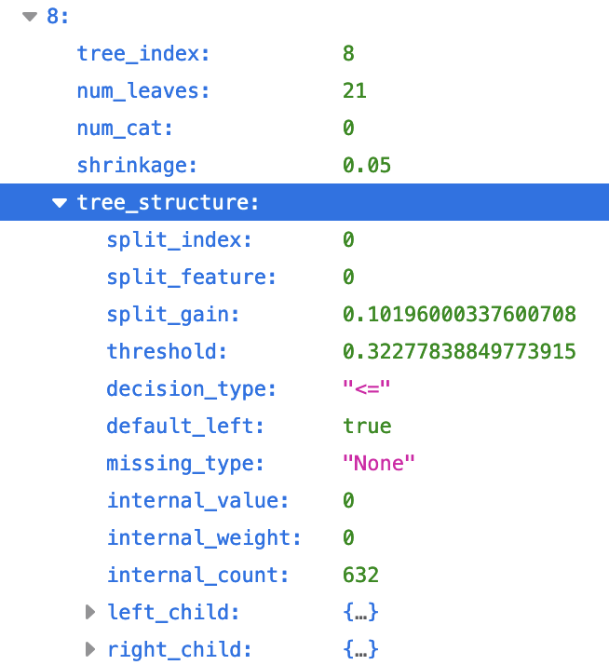
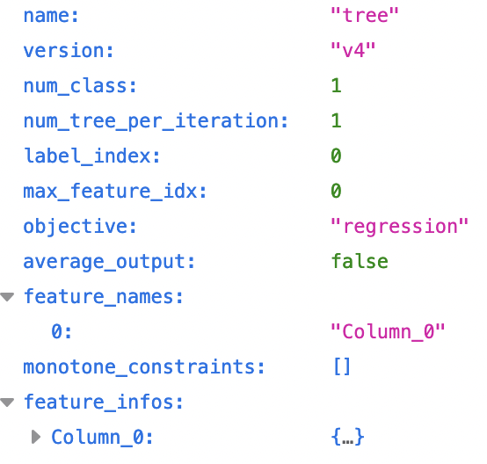
General Tree Structure
1 input 1 output numerical (constant)

Slide 4

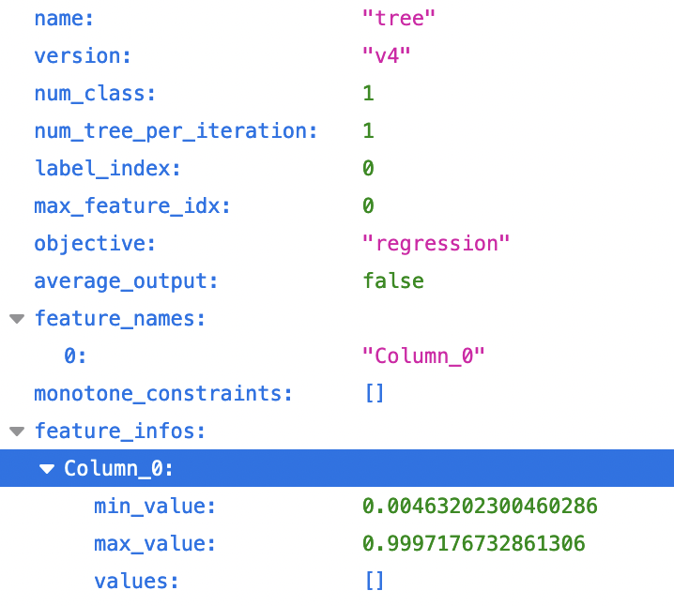
General Tree Structure
1 input 1 output numerical (linear)

Slide 5
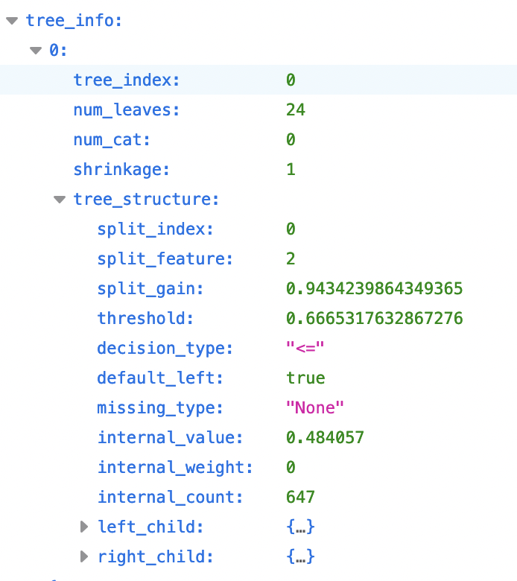
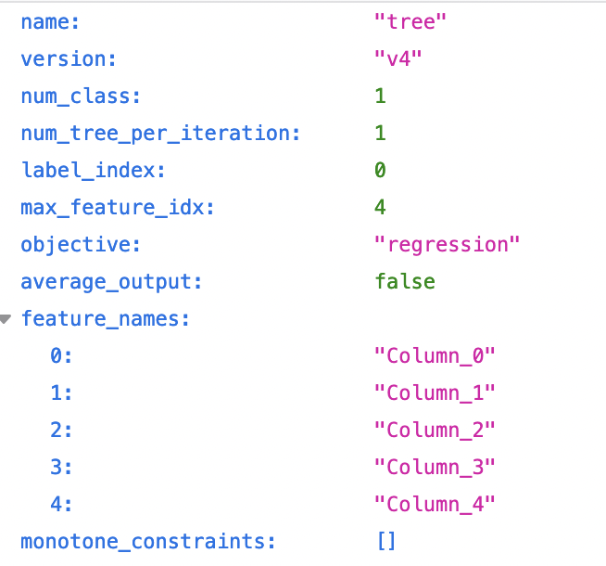
General Tree Structure
5 inputs 5 outputs numerical (linear)

Slide 6
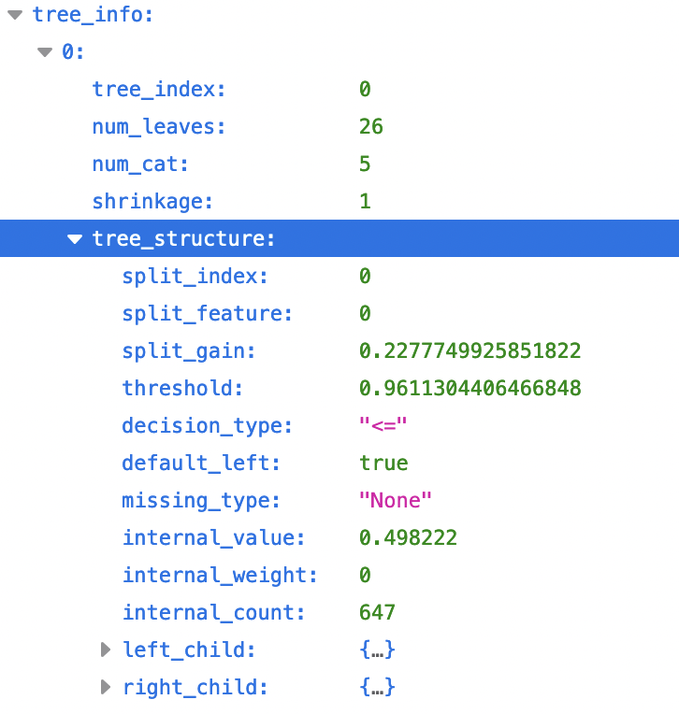
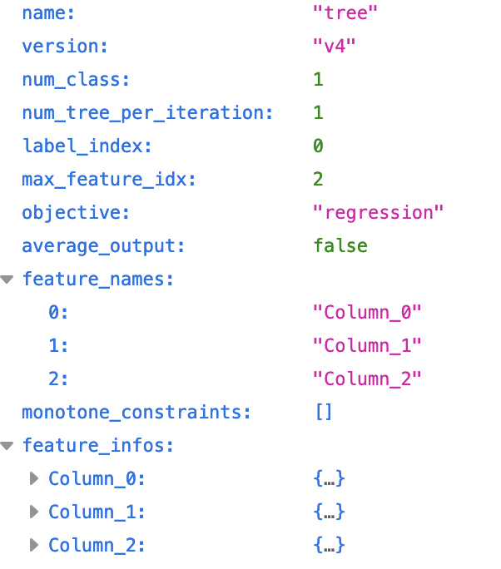
General Tree Structure
1 numerical 2 categorical inputs 5 outputs (linear)

Slide 7
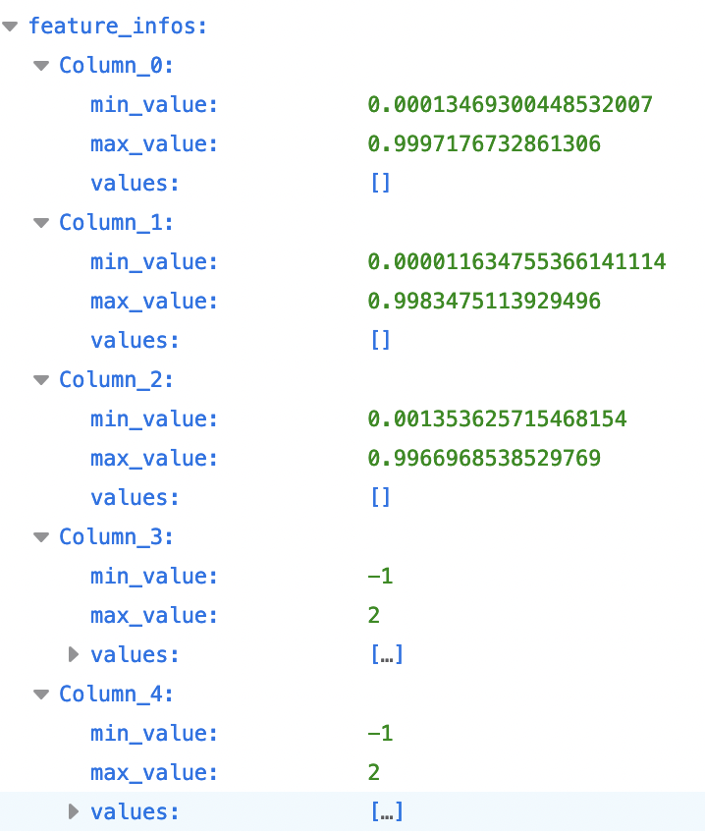
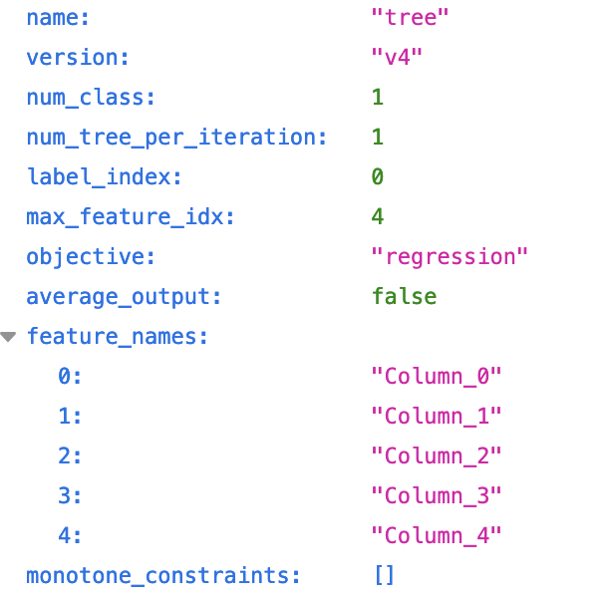
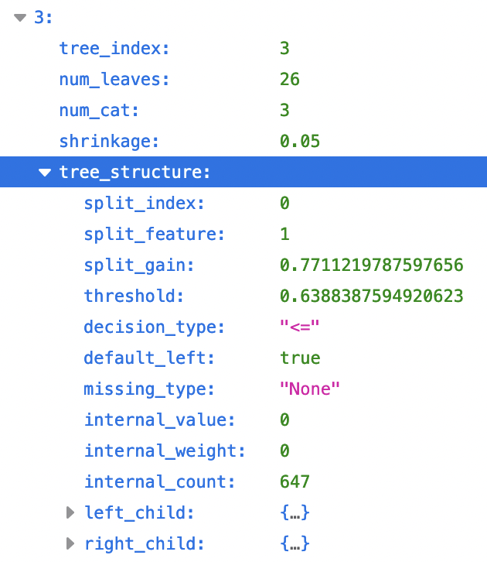
General Tree Structure
3 continuous 2 categorical inputs 5 outputs (linear)

Slide 8
Summary
Cached Data:
Name
Version
Num_Class
Num_Tree_Per_Iteration
Objective
Max feature idx
Monotone constraints
Parent tree info:
Index
Num leaves
Num cat
Shrinkage
Decision type
Weights and Values
Computed Data:
min/max col value
Leaf/child values
Split indices
Split gains
Threshold
Bounds

